Slide 1

School 179 team

Slide 2
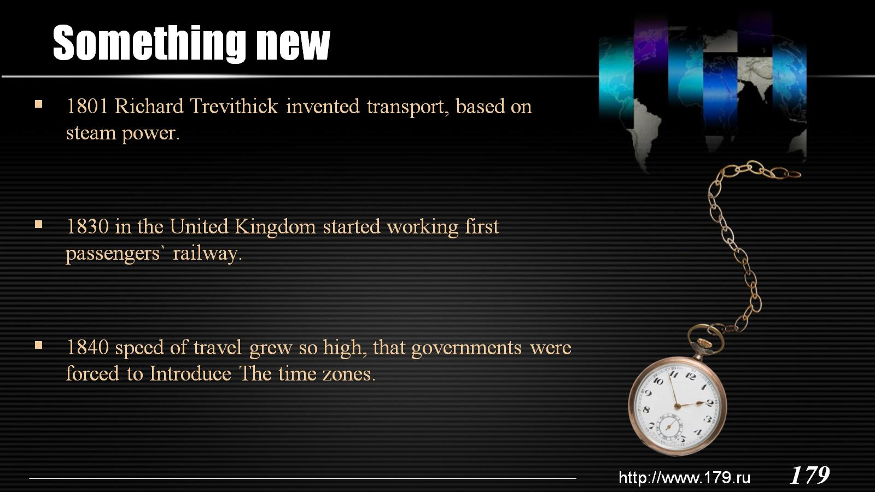
Something new

Slide 3
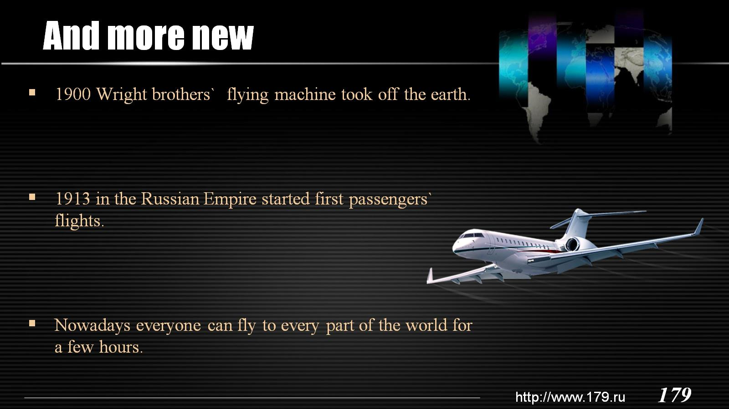
And more new

Slide 4
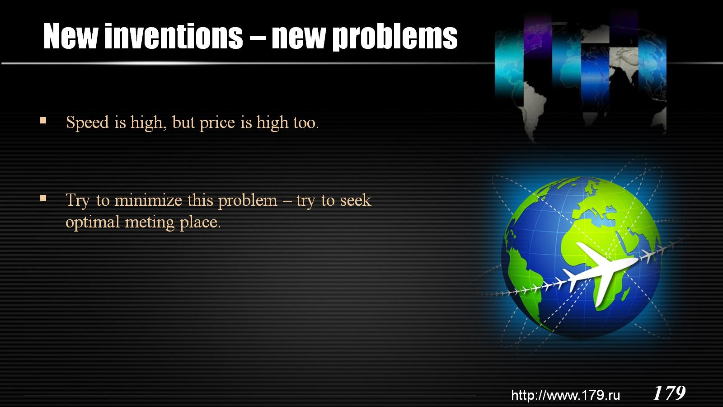
New inventions – new problems

Slide 5

Algorithm and base

Slide 6
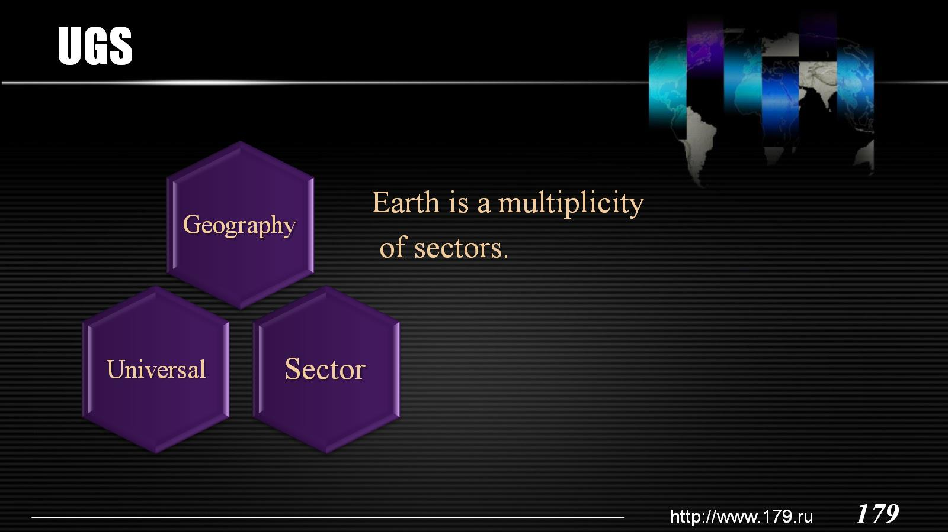
UGS

Slide 7
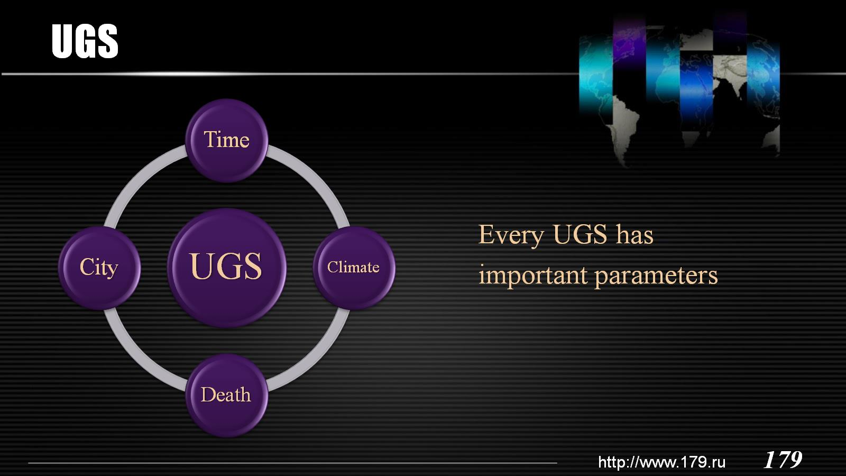
UGS

Slide 8
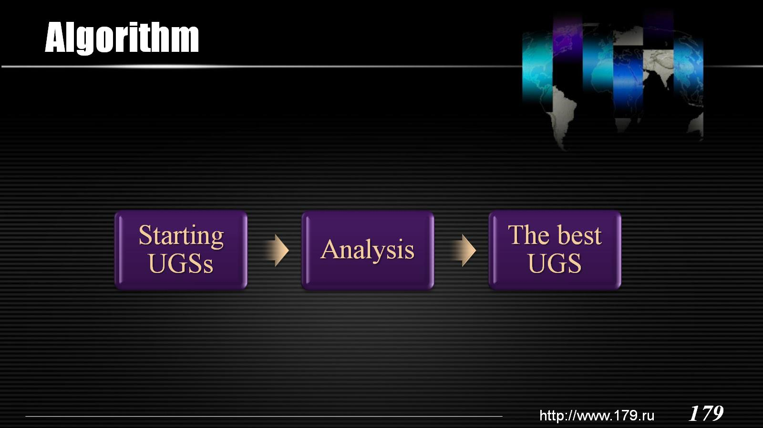
Algorithm

Slide 9
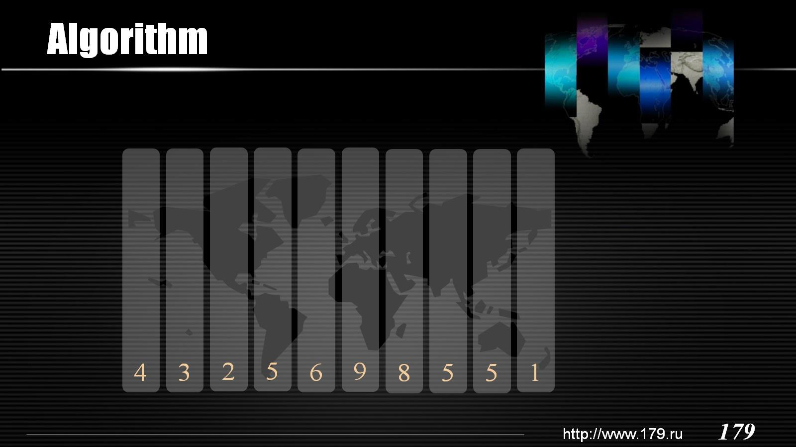
Algorithm

Slide 10
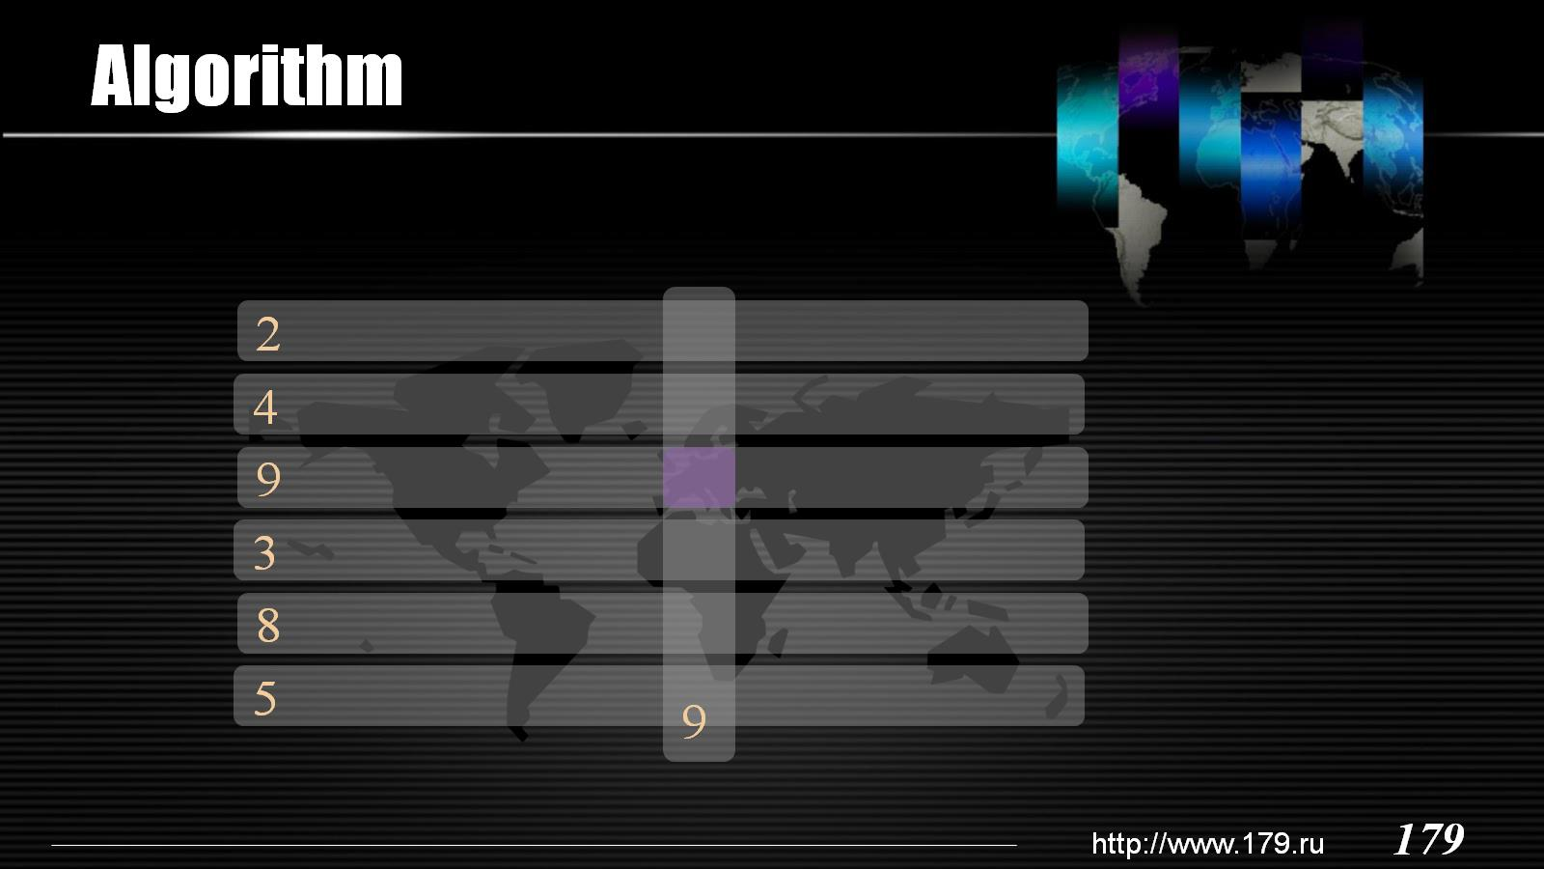
Algorithm

Slide 11

jetlag

Slide 12
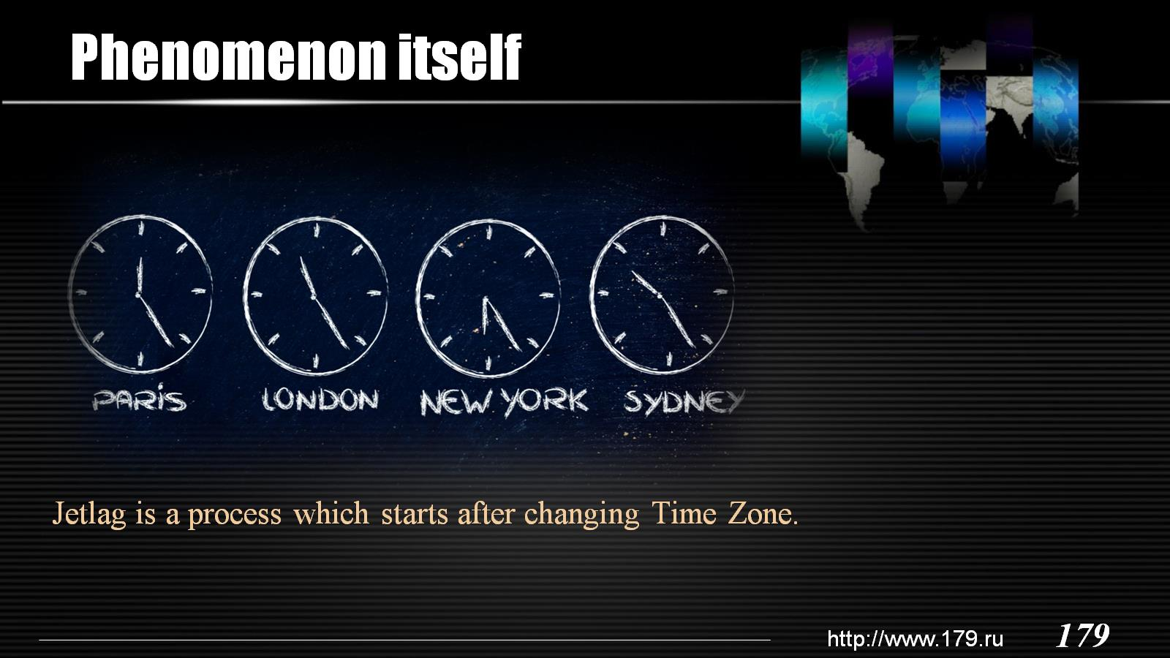
Phenomenon itself

Slide 13
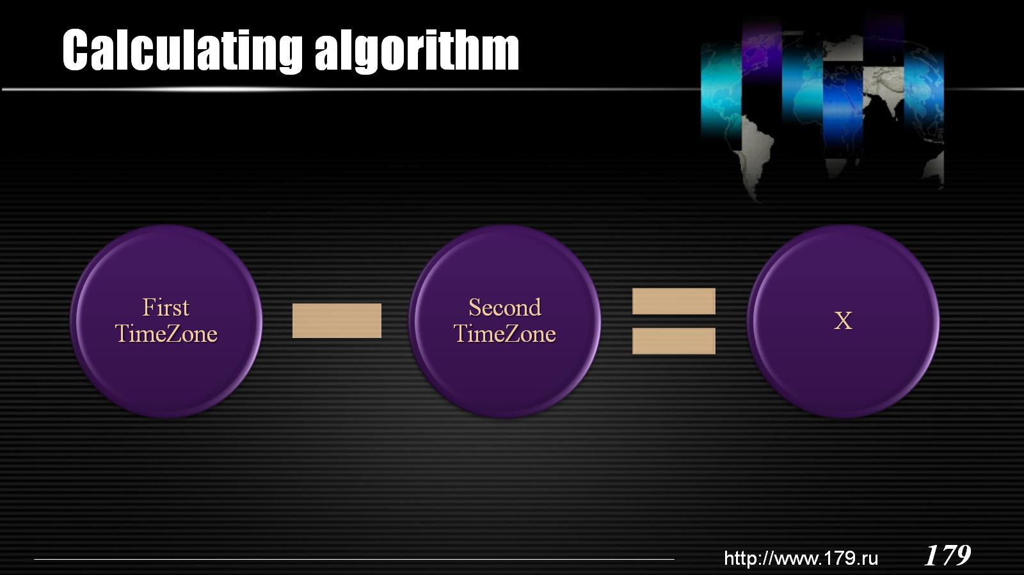
Calculating algorithm

Slide 14
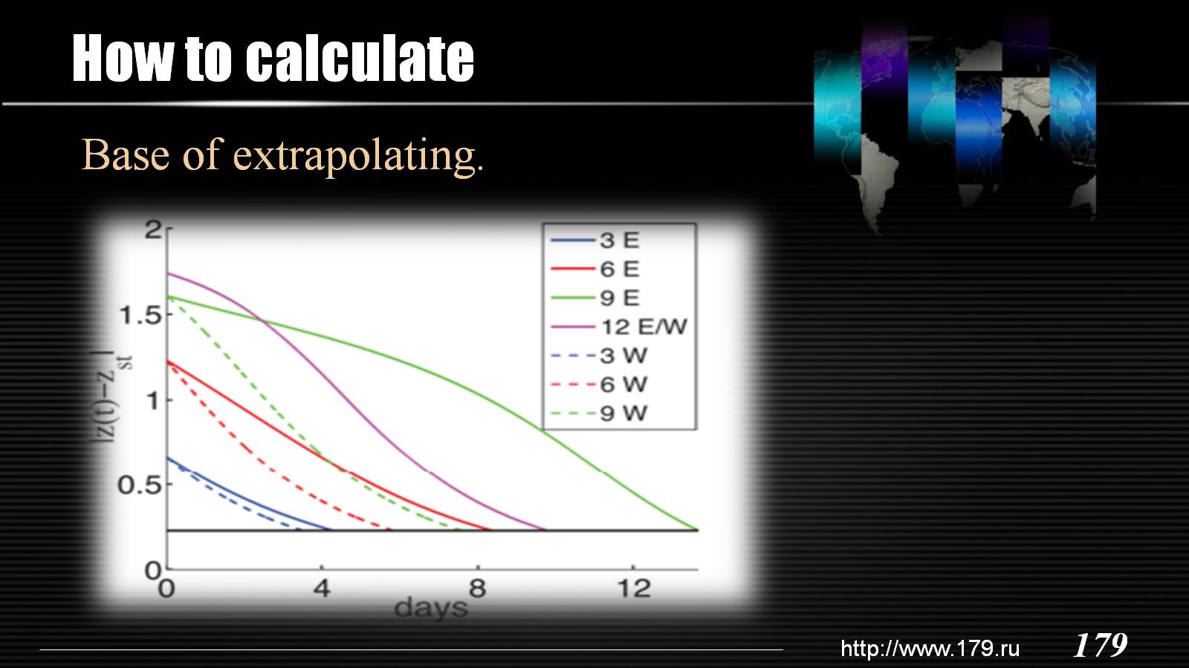
How to calculate

Slide 15
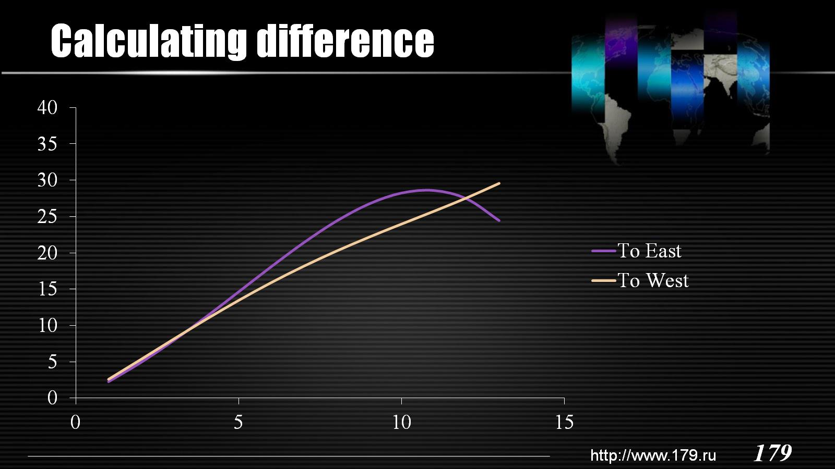
Calculating difference

Slide 16

Acclimatization

Slide 17
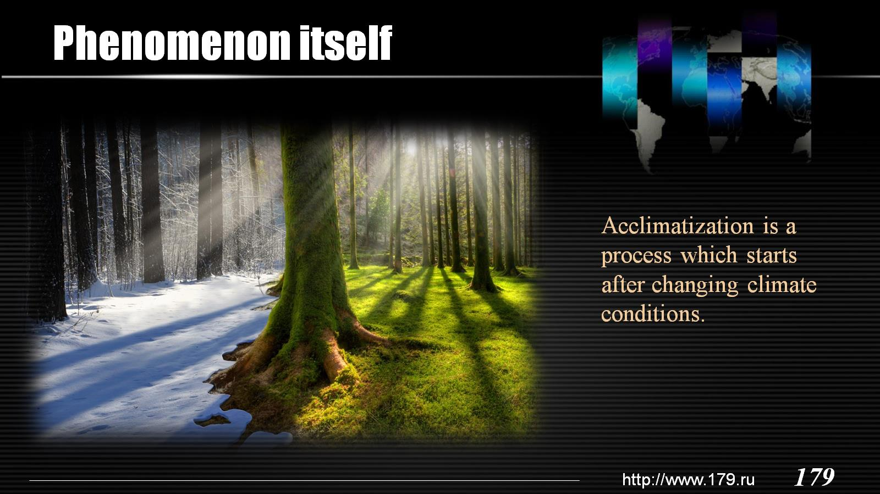
Phenomenon itself

Slide 18
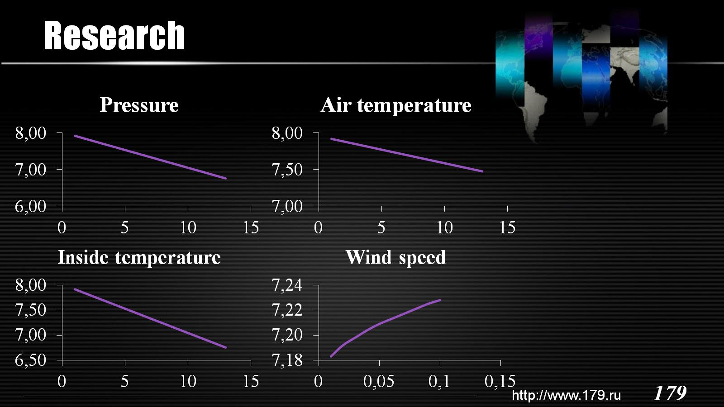
Research

Slide 19
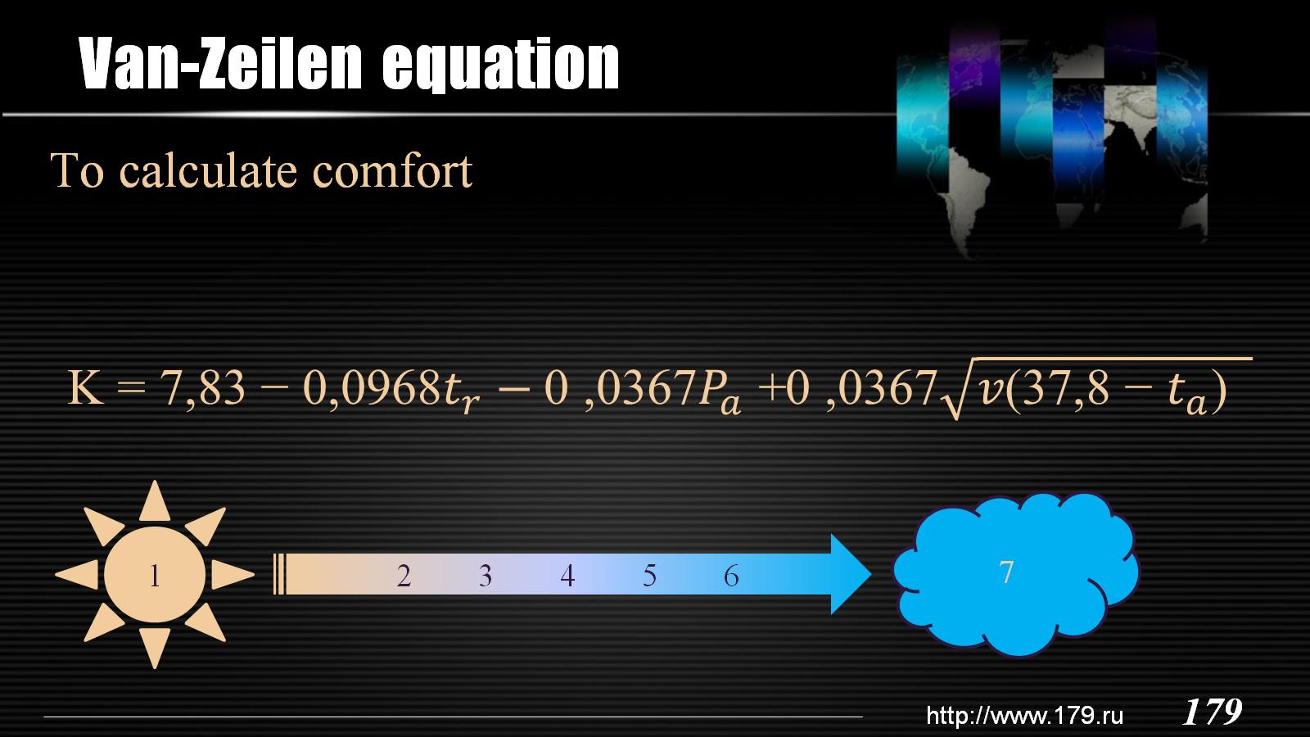
Van-Zeilen equation

Slide 20
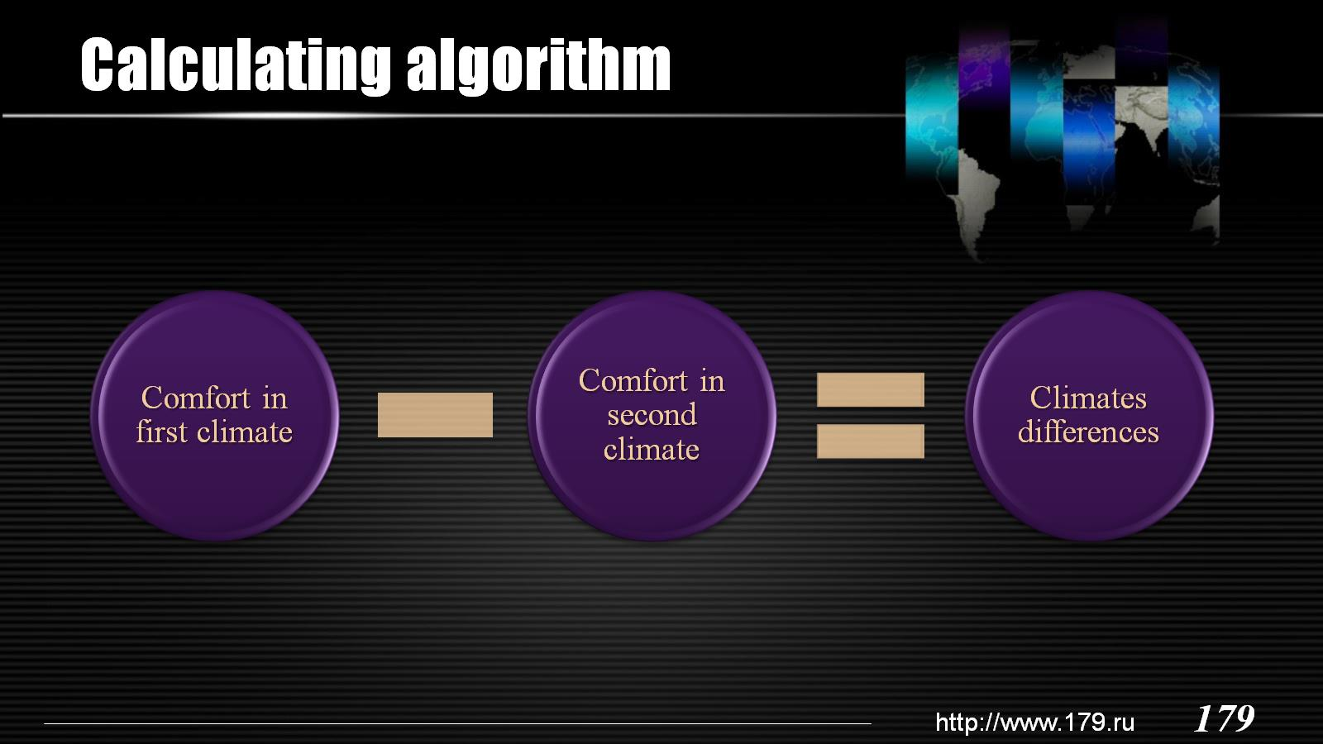
Calculating algorithm

Slide 21
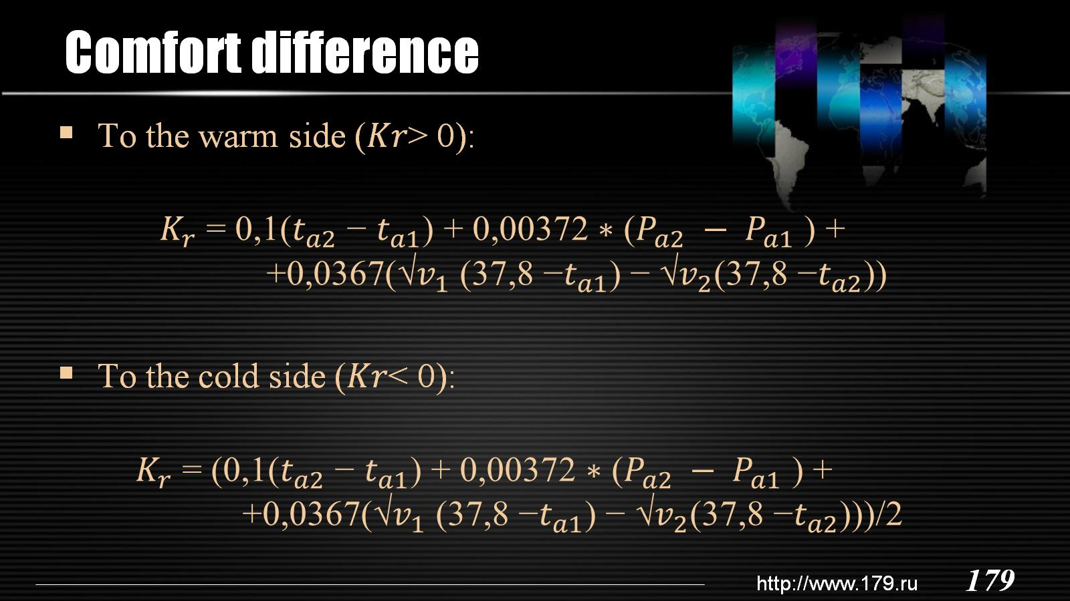
Comfort difference

Slide 22

Cost

Slide 23
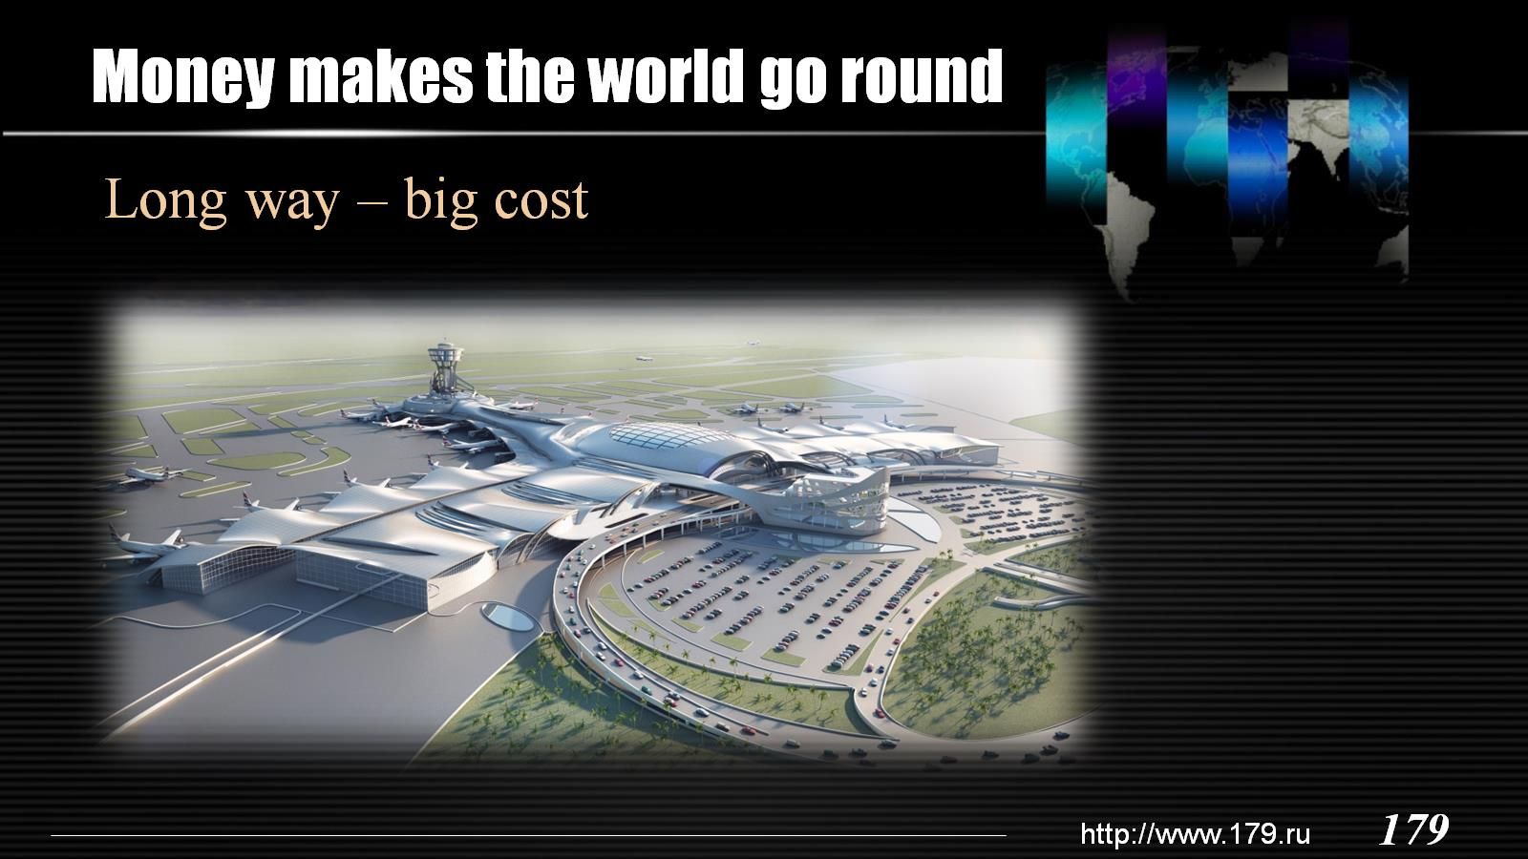
Money makes the world go round

Slide 24
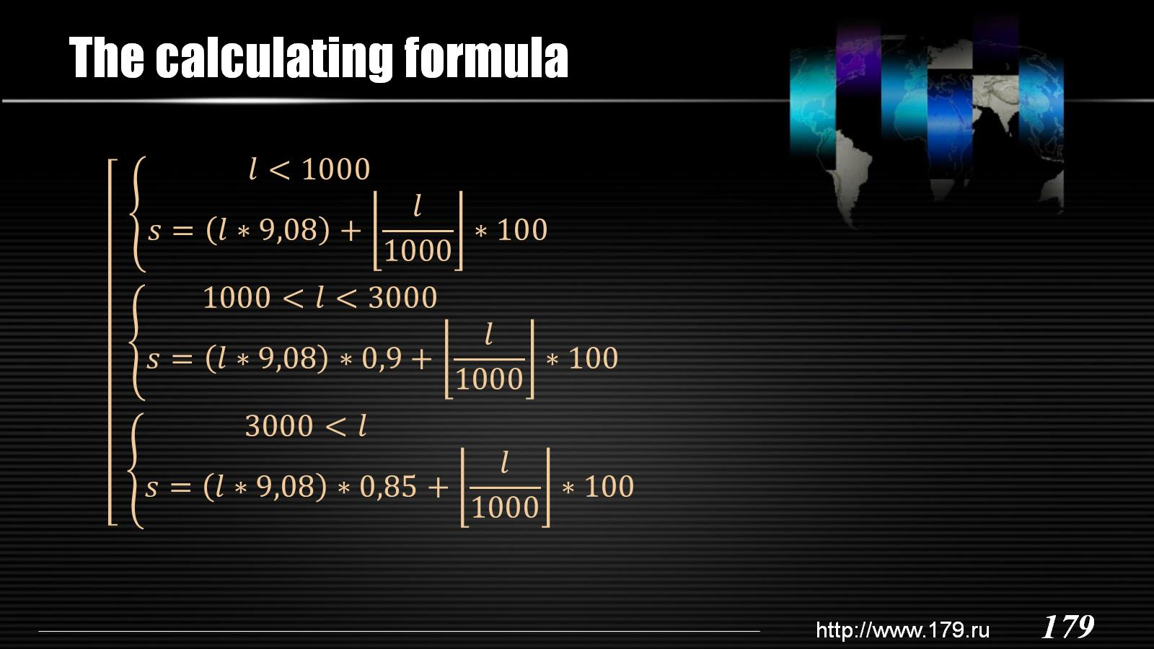
The calculating formula

Slide 25

Conclusion

Slide 26
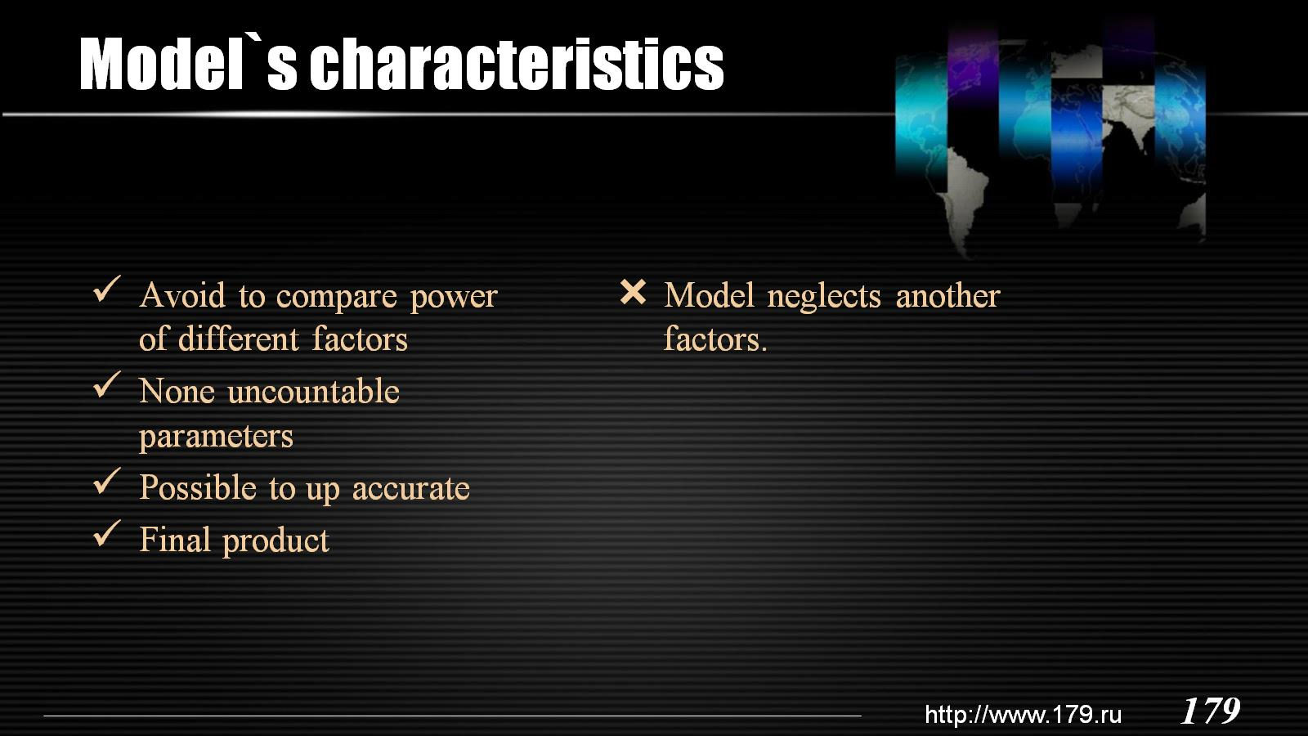
Model`s characteristics

Slide 27

Thank you for attention

