Slide 1

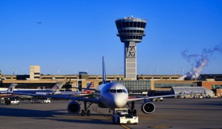
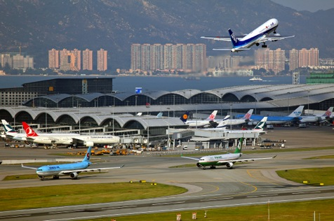
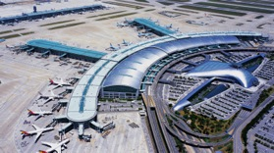
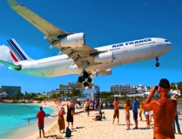
The International Mathematical
Modeling Challenge 2017
Simon Lhez, Tomás Popowsky, Andrés Amaya and Andrés Eskenazi St Andrew’s Scots School, Buenos Aires, Argentina

Slide 2
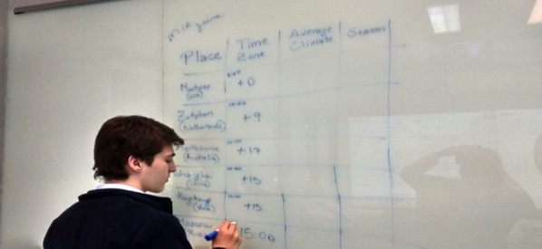
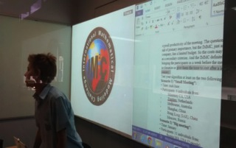
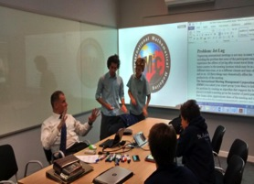
Index of Contents
Problem
Approach
Our Assumptions
Main Variables
Dividing the World
Database
Mini Algorithms and weights
Algorithm
Results
Evaluation

Slide 3
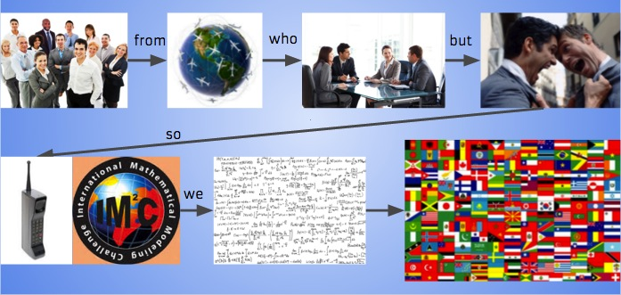
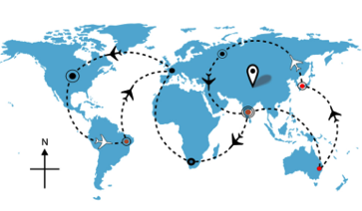


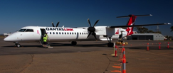
1) Problem
Our interpretation:
“if you have delegates from all over the world, where should your hold a conference to minimise the amount of jet-lag suffered by the participants?”

Slide 4
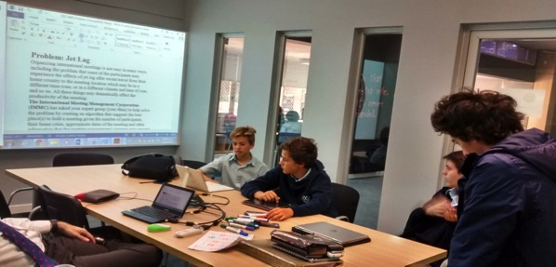
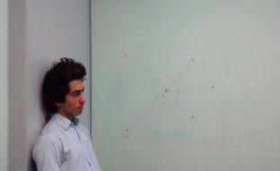

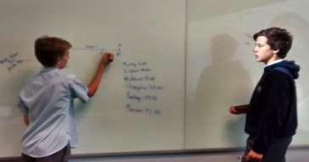
2) Approach
In our 5 day week, we decided to divide tasks, for:
Research
Mathematics and the Algorithm
Time was running out!

Slide 5
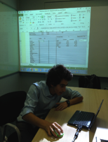
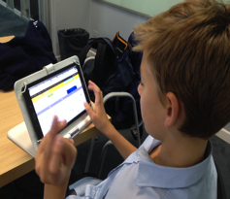
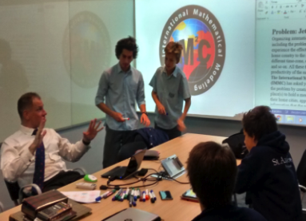
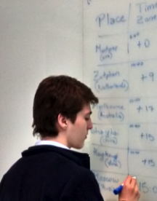
3) Our Assumptions
There are 5 main assumptions we made that enabled us to produce our algorithm:
Big City/Capital
56 Regions of the World (seen later on)
Weighted Participants
Sine curve daylight
Business/First Class

Slide 6
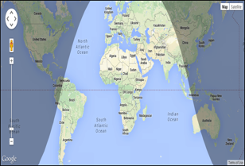
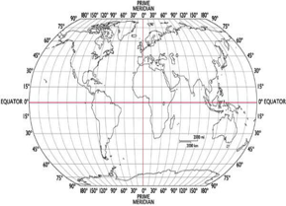
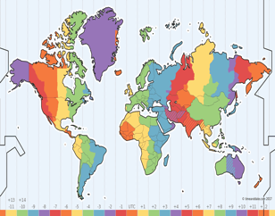
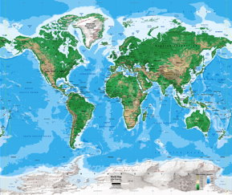
4) Main Variables
Out of all of the factors that affect our jetlag, we decided to focus on the main four:
Daylight Hours
Latitude and Longitude
Time Zone
Altitude
Other factors like sleep, diet, age are difficult to model mathematically

Slide 7
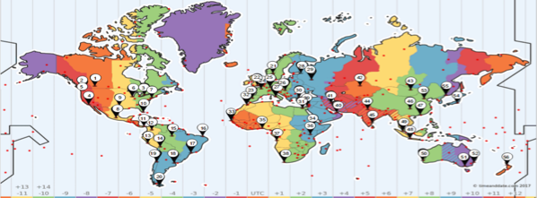
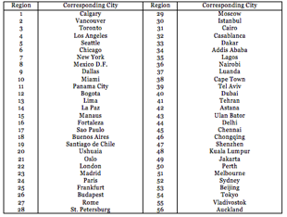
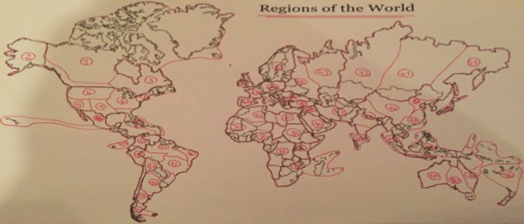
5) Dividing the World
We assumed the world could be divided into 56 regions, each one with a main city, that would be representative of each and every corner!
N
Location of each city in the world
Notes:
Some Limitations

Slide 8
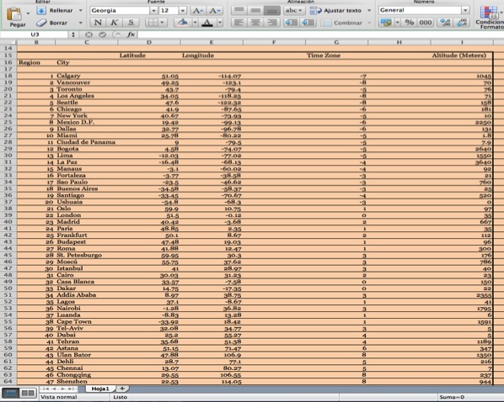
6) Database
Now that the world was divided (archaically), we could begin to make a large Excel database where we searched for each city each one of the main four variables that affect Jetlag!
Important Notes:
Altitude is in meters
Lat/Long in decimals

Slide 9
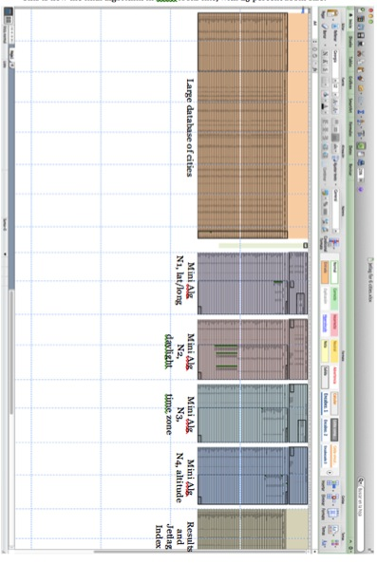
7) Mini Algorithms and Weights
In essence, we created 4 small algorithms that run for each different variable. Hence, the result is a combination of all of these!
Each mini algorithm has the same weight (25 percent) so these are equally important. Nonetheless, this can be changed, depending on the IMMC requirements!
Main Equation is Large Algorithm = ∑ Mini Algorithms

Slide 10
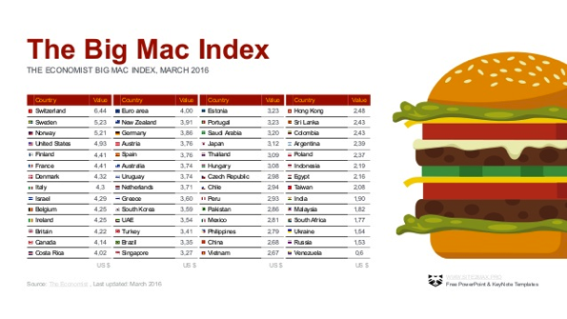
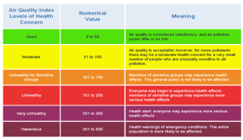
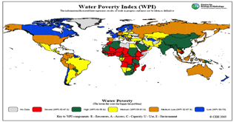
8) The Algorithm – Jetlag Index
To measure how Jetlagged a city could potentially be for the assisting participants, we created the Jetlag Index.
This is a value that ranges from 0 to 100, where the closer to 100 means the city is better to held the conference at!
We will see how the index is computed…

Slide 11
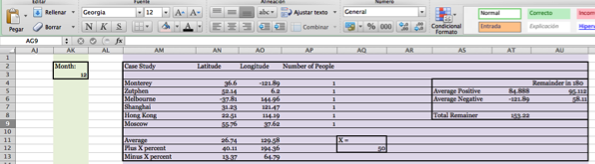
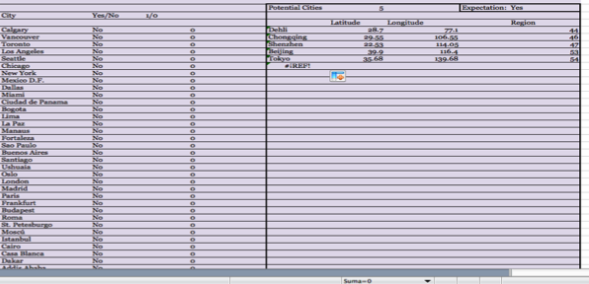
Mini Algorithm N1 – Latitude and Longitude
Basic algorithm procedure:
We took the averages of Lat/Long
Defined a paramenter X, which is the +/- margin of spread from the algorithm
If a city in the database is inside these margins, then we add 25 to its Jetlag Index

Slide 12
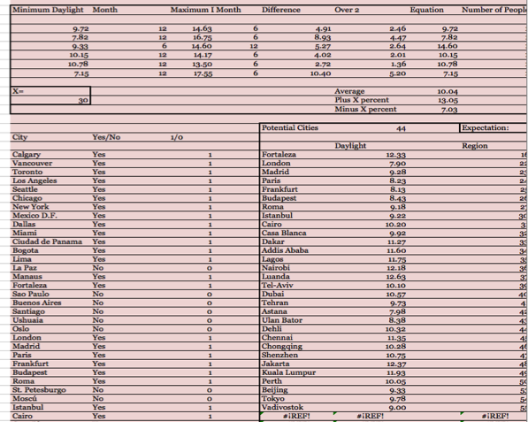

Mini Algorithm N2 – Daylight Hours
Same procedure than before
Daylight was modelled with the following sine curve:
Where A is amplitude, B is the desired period, C the left shift, D the upwards shift, and x is month

Slide 13
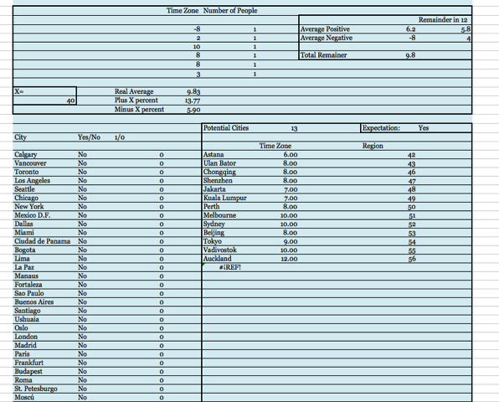

Mini Algorithm N3 – Time Zones
Same procedure than before
Some Formulae:
1) Sine
2) Look Up

Slide 14
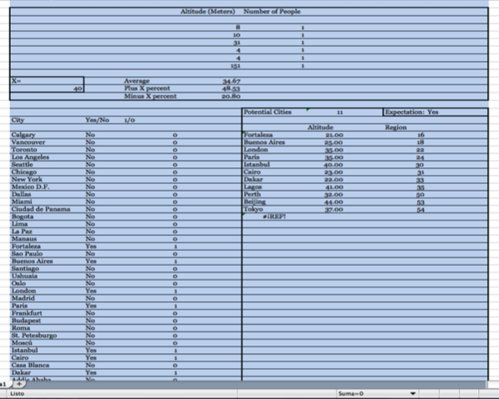
Mini Algorithm N4 – Altitude
Same procedure than before
Each one of the mini algorithms weights can be changed
The X parameters can be made tighter or more flexible as well

Slide 15
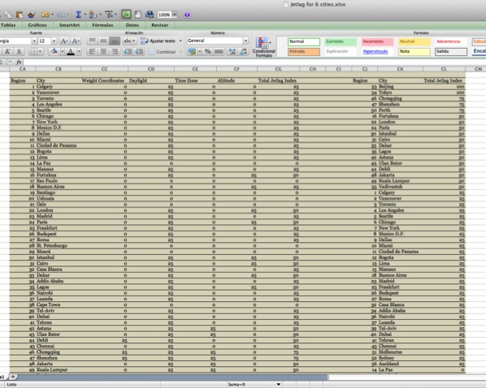
Jetlag Index Results
All in all, after running the four mini algorithms, all the weights adds up
The final values are displayed automatically in the Jetlag Index table, and each city/region is ordered from largest (100 – the best) to smallest (0 – the worst)

Slide 16
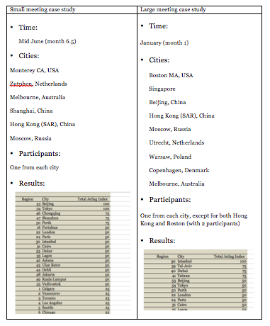



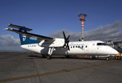

9) Results
These were our results for each case study:
1) Small Meeting: The algorithm returned Beijing and Tokyo with a Jetlag Index of 100
2) Large Meeting: The algorithm returned Istanbul with a Jetlag Index of 100

Slide 17
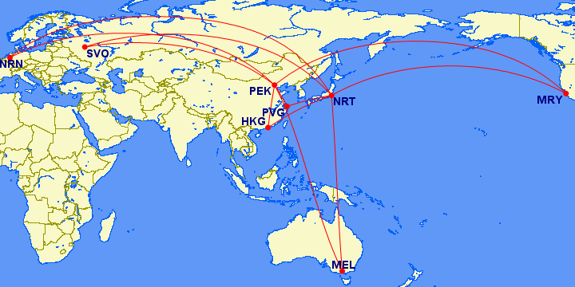
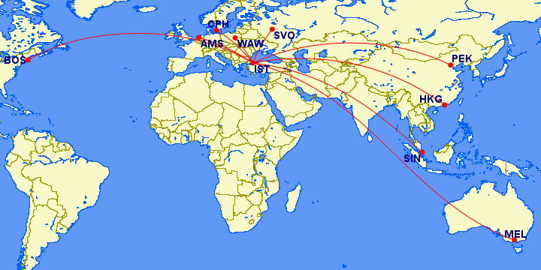
9) Results
These maps display the visual representation of the routes of the that would be eventually operated to arrive to the conference regions determined by our Algorithm!
The one above is for the small meeting, while the one below is for the large meeting!

Slide 18
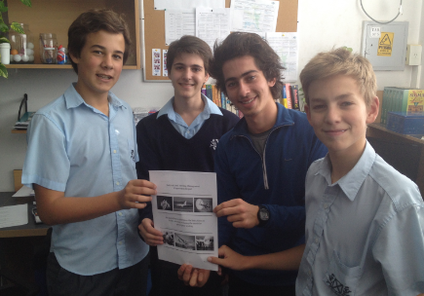
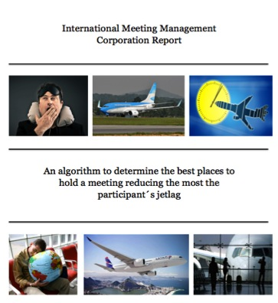
Solution
A complex spreadsheet and a 4000 word report

Slide 19

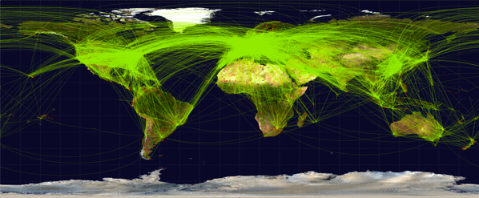
10) Evaluation
Some Ideas to discuss:
Reliability and Assumptions
X parameters, weights flexibility
Further Investigation:
Diet, flight direction, mean temperatures, XYZ coordinates, more regions, flight costs!

Slide 20
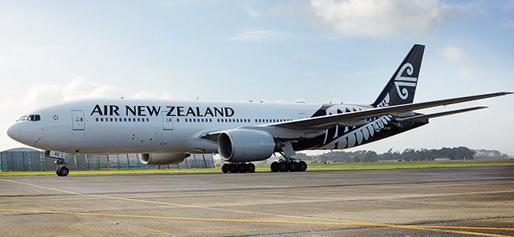

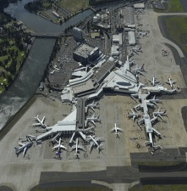
Acknowledgements
Firstly, we thank our school for providing us with the space and time to do the project!
Also, special thanks to all of the maths department, specially to Mark and James!
Last but not least, our infinite thanks to COMAP and the IMMC!

Slide 21



Sources
http://www.nhs.uk/Conditions/Jet-lag/Pages/Symptoms.aspx
http://www.medicalnewstoday.com/articles/165339.php
https://en.wikipedia.org/wiki/Jet_lag
http://www.foxnews.com/travel/2014/11/17/key-factors-that-affect-jet-lag.html
https://www.timeanddate.com/sun
http://www.jetlagrooster.com
http://www.medicinenet.com/jet_lag/article.htm
http://www.health.com/health/gallery/0,,20322187,00.html
http://www.timetemperature.com/time-zone-maps/world-time-zone-map.shtml
http://everytimezone.com
https://www.geovista.psu.edu/grants/MapStatsKids/MSK_portal/concepts_latlg.html
https://www-istp.gsfc.nasa.gov/stargaze/Slatlong.htmgo

