Slide 1



IMMC
Jet Lag
Presenter :
LEE SEUNG MOK
PAENG JINHEE
KO GEONUNG
KIM KIBUM
G
SHS

Slide 2
Introduction
Part. I : Define productive meeting
Fatigue
Productivity of meeting
Work Efficiency
Sleep Time
Participant’s productivity
Body Cycle
Part. II : Find best location
?
Using programming (C++)

Slide 3
Assumptions
1. Same Schedule for all Participants
2. 72 hours(3d) for perfect Adaptation
3. Plane through the Great Circle
4. All Participants arrive Simultaneously
5. Location only affects Time Difference
Environments are not considered

Slide 4











Variables
$$t$$
Time variable
$$F(t)$$
Fatigue (0 to 1)
$$E\left(t\right)$$
Efficiency (0 to 1)
$$B(t)$$
Body cycle
$$P_{1}$$
Home place
$$P_{2}$$
Meeting place
$$d$$
Spherical distance of $P_{1}P_{2}$
$$φ$$
Time gap between $P_{1}$and $P_{2}$
$$L$$
Critical efficiency (criterion for “productive”)

Slide 5
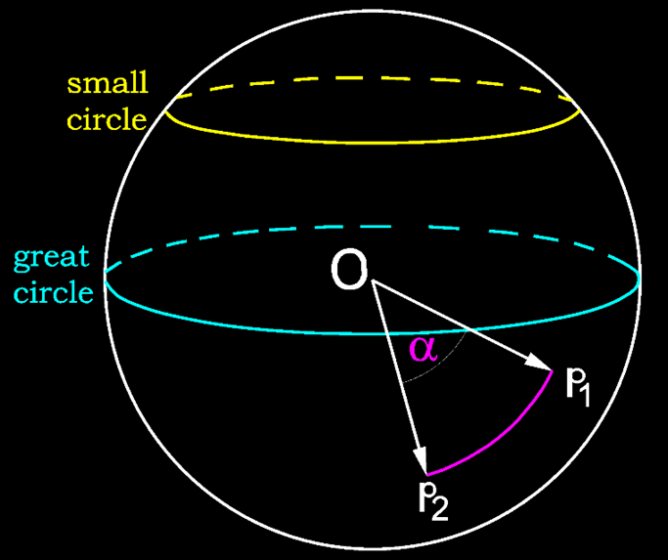



Flight Time Estimation
From
$P_{1}\left(r_{E}, θ_{1}, φ_{1}\right)$
To
$P_{2}\left(r_{E}, θ_{2}, φ_{2}\right)$
Time difference :
$$φ=\frac{φ_{2}−φ_{1}}{2π}∙24hr$$
Distance :
$$d=\frac{r_{E}+h_{f}}{u}\cos^{−1}\left(\cos{φ_{1}}\cos{φ_{2}}\cos\left(θ_{1}−θ_{2}\right)+\sin{φ_{1}}\sin{φ_{2}}\right)$$

Slide 6
Flight Time Estimation
Justification
(latitude/longitude) | city 1 | city2 | Duration | Actual Duration
Case 1 | Incheon (37.47/126.45) | Dallas (32.85/-96.85) | 13.47hr | 13.53hr
Case 2 | Sofia (46.70/23.41) | Tokyo (35.67/139.75) | 10.87hr | 11.35hr
Errors in Case 1
1.18%
A valid assumption
Errors in Case 2
4.23%

Slide 7
Relationship between Fatigue and Efficiency
Productivity
High Fatigue
Low Productivity
Low Fatigue
I’m tired…..zzz
I don’t want to work.
High Productivity

Slide 8



Fatigue
Factor
E
R(t)
B(t)
Efficiency
Sleep Time
Body Cycle

Slide 9


Relationship between Fatigue and Efficiency
Efficiency
Efficiency
Critical Fatigue Point$(P_{c})$
Fatigue
$$E= \frac{1}{2}− \frac{1}{2} \tanh\left(k\left(F−p_{c}\right)\right)$$

Slide 10





Fatigue - efficiency
$$\frac{dF}{dt}$$
$$∝$$
$$f_{1}E$$
$$=$$
F
E
$$\frac{dF}{dt}=f_{1}E$$

Slide 11




Fatigue – sleep time
Sleep at 24:00, Wake at 8:00
$$R\left(t\right)=\left\{\begin{aligned}1, &0≤t≤8 \\ 0, &8≤t≤24\end{aligned}\right.$$
While sleeping, Fatigue is decreasing
$$\frac{dF}{dt} ∝−R$$
$$\frac{dF}{dt}= −f_{2}R$$
$$\frac{dF}{dt}= f_{1}E−f_{2}R$$

Slide 12



Fatigue – body cycle
Body cycle $≒$ Insolation
Insolation
Body cycle
1
0:00
12:00
24:00
-1
$$B\left(t\right)=\sin\left(\frac{2π }{24hr}\left(t−6\right)\right)$$

Slide 13


Fatigue – body cycle
Body cycle → not directly affect fatigue
$$\frac{dF}{dt}= f_{1}E−f_{2}R$$
During the day
Few fatigue load
During the night
A lot of fatigue load
$$f_{1}= \frac{c_{max}+c_{min}}{2}− \frac{c_{max}− c_{min}}{2}\tanh\left(3B(t)\right)$$

Slide 14

Fatigue – body cycle
Body cycle → not directly affect fatigue
$$\frac{dF}{dt}= f_{1}E−f_{2}R$$
During the day
Few fatigue relieve
During the night
A lot of fatigue relieve
$$f_{2}= \frac{d_{max}+d_{min}}{2}− \frac{d_{max}− d_{min}}{2}\tanh\left(3B(t)\right)$$

Slide 15
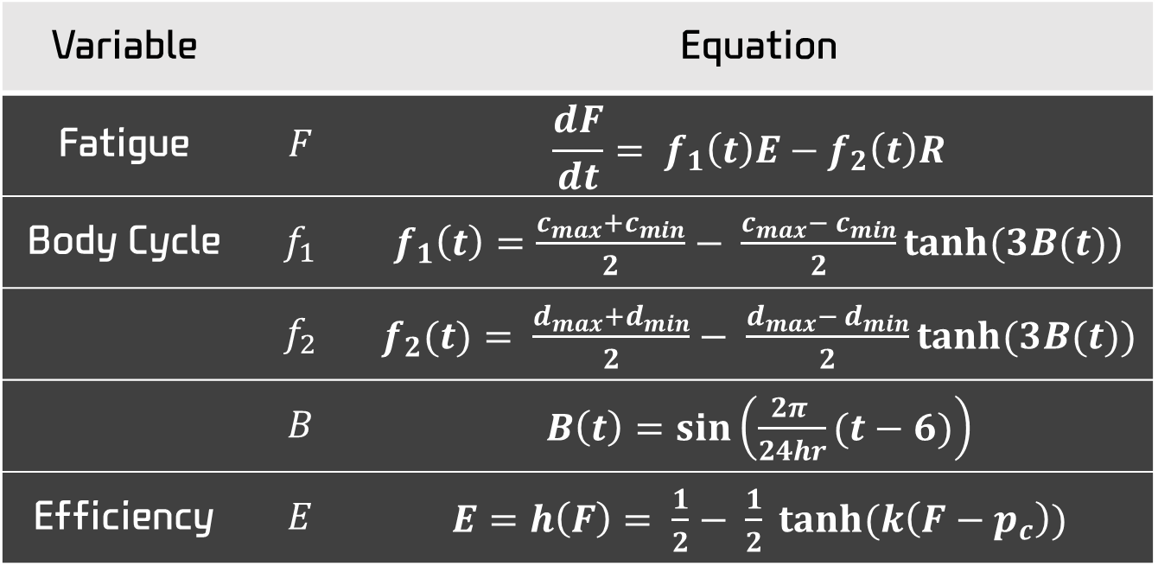
Relationship between Fatigue and Efficiency
Variable |  | Equation
Fatigue | $$F$$ | $$\frac{dF}{dt}= f_{1}\left(t\right)E−f_{2}\left(t\right)R$$
Body Cycle | $$f_{1}$$ | $f_{1}\left(t\right)=\frac{c_{max}+c_{min}}{2}− \frac{c_{max}− c_{min}}{2}\tanh{(3B(t))}$
 | $$f_{2}$$ | $f_{2}(t)= \frac{d_{max}+d_{min}}{2}− \frac{d_{max}− d_{min}}{2}\tanh{(3B(t))}$
 | $$B$$ | $B\left(t\right)=\sin\left(\frac{2π }{24hr}(t−6)\right)$
Efficiency | $$E$$ | $E=h\left(F\right)= \frac{1}{2}− \frac{1}{2} \tanh{(k\left(F−p_{c}\right))}$

Slide 16



Relationship between Fatigue and Efficiency
Coefficient values
Borb, A. A., & Achermann, P. (1999). Sleep homeostasis and models of sleep regulation.
Journal of biological rhythms, 14(6), 559-570.
$$\frac{d}{dt}SWA\left(t\right)=rcSWA\left(t\right)\left(1−\frac{SWA\left(t\right)}{S\left(t\right)}\right)\frac{F\left(t\right)}{F_{U}}−{fc}_{R}\left(SWA\left(t\right)−{SWA}_{L}\right)R\left(t\right)$$
$$−{fc}_{W}\left(SWA\left(t\right)−{SWA}_{L}\right)W(t)$$
$$\frac{d}{dt}F\left(t\right)=−gcSWA\left(t\right)+rs(F_{U}−F(t))$$
$$W\left(t\right)=\left\{\begin{aligned}0, &0≤t≤8 \\ 1, &8≤t≤24\end{aligned}\right.$$
$$fc$$ | $${fc}_{R}$$ | $${fc}_{W}$$ | $$gc$$ | $$rs$$ | $${SWA}_{L}$$ | $$SWA\left(t\right)$$ | $$F_{U}$$ | $$F(0)$$
0.283 | 0.236 | 1 | 0.00835 | 0.0009167 | 0.0177 | 0.083 | 1 | 0.5563
Borb, A. A., & Achermann, P. (1999). Sleep homeostasis and models of sleep regulation.
Journal of biological rhythms,

Slide 17
Relationship between Fatigue and Efficiency
Coefficient values
Borb, A. A., & Achermann, P. (1999). Sleep homeostasis and models of sleep regulation.
Journal of biological rhythms, 14(6), 559-570.
Find tuples of the coefficients with
the smallest RMS average of the difference between
“Sleep Homeostasis and Models of Sleep Regulation”

Slide 18
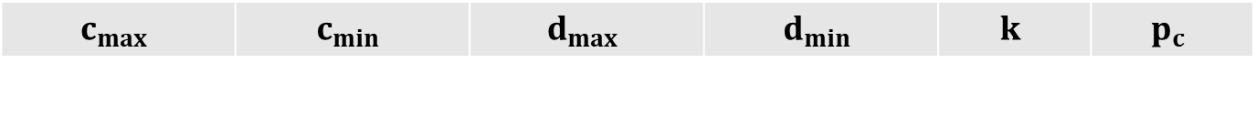
Relationship between Fatigue and Efficiency
Coefficient values
Our model value
Theoretical value
Comparison when they converge
$$c_{max}$$ | $$c_{min}$$ | $$d_{max}$$ | $$d_{min}$$ | $$k$$ | $$p_{c}$$
0.0003 | 0.00004 | 0.0003 | 0.00005 | 3.0 | 0.60
Results of most appropriate coefficients

Slide 19
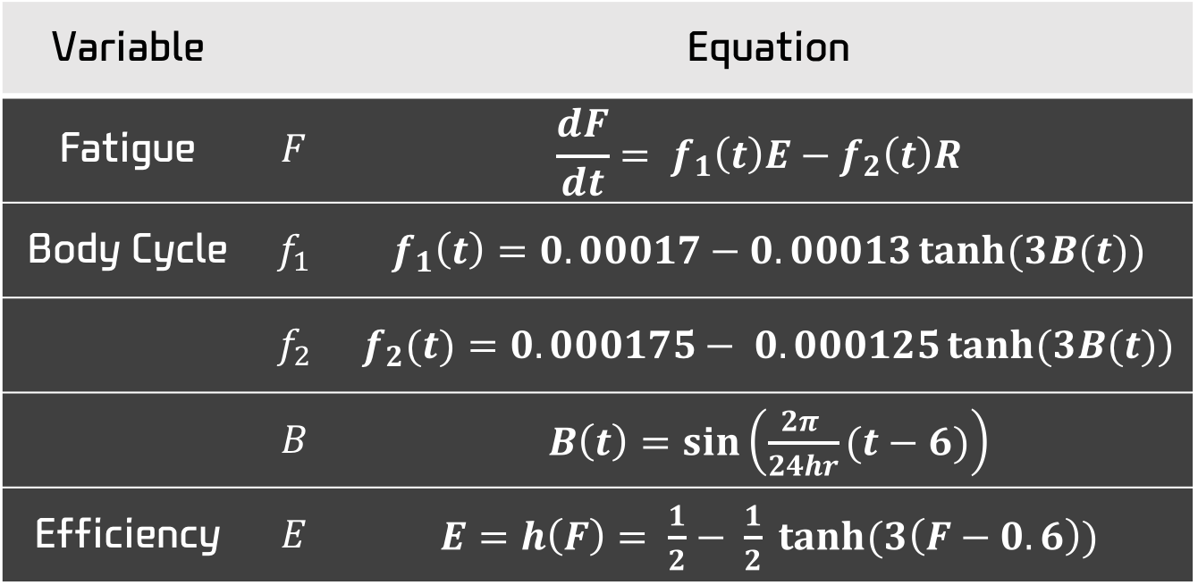
Relationship between Fatigue and Efficiency
Variable |  | Equation
Fatigue | $$F$$ | $$\frac{dF}{dt}= f_{1}\left(t\right)E−f_{2}\left(t\right)R$$
Body Cycle | $$f_{1}$$ | $f_{1}\left(t\right)=0.00017−0.00013\tanh{(3B(t))}$
 | $$f_{2}$$ | $f_{2}(t)=0.000175− 0.000125\tanh{(3B(t))}$
 | $$B$$ | $B\left(t\right)=\sin\left(\frac{2π }{24hr}(t−6)\right)$
Efficiency | $$E$$ | $E=h\left(F\right)= \frac{1}{2}− \frac{1}{2} \tanh{(3\left(F−0.6\right))}$

Slide 20
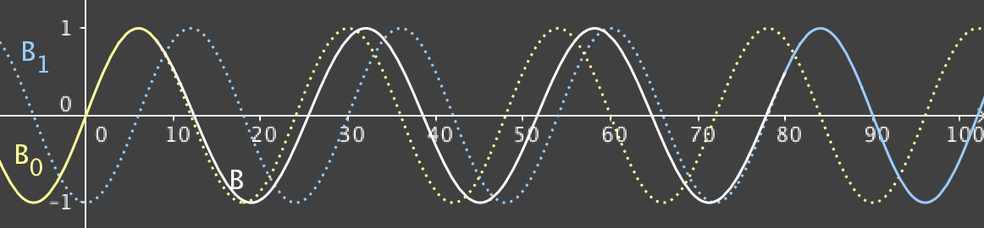

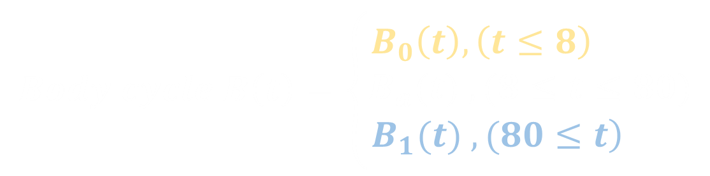
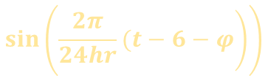
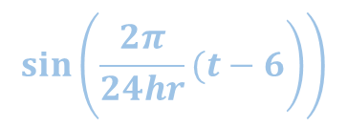

Change of Body Cycle after the Flight
$$φ$$
$$Body cycle B\left(t\right)=\left\{\begin{aligned}B_{0}\left(t\right),\left(t≤8\right) \\ B_{a}(t) , (8≤t≤80) \\ \left.B_{1}(t) , (80≤t\right) \end{aligned}\right.$$
Home
Adaption
Meeting
$$\sin\left(\left.\frac{2π}{24hr}(t−6−φ\right)\right)$$
$$B_{a}\left(t\right)=\sin\left(\frac{2π}{24hr}\frac{\left(72+φ\right)hr}{72hr}\left(t−6−\frac{74φ}{72+φ}\right)\right)$$
$$\sin\left(\left.\frac{2π}{24hr}(t−6\right)\right)$$

Slide 21

Change of Body Cycle after the Flight
$$φ=12h$$
Fatigue value before, while, and after the flight.
Home place
plane
Meeting place
8:00

Slide 22

Definition of productive meeting
Worst efficient
Non-productive
L
Critical value
Productive
Best efficient
$$h(L)= \frac{h(F_{max})+{h(F}_{min})}{2}$$
Critical value

Slide 23

Definition of productive meeting
$$φ=12h$$
Fatigue value before, while, and after the flight.
Home place
plane
Meeting place
8:00
Define productive working time for participant

Slide 24


Definition of productive meeting
Meeting is productive
2/3 of all participants are productive
G
A
Productive
Productive
6:30 PM
$$6>7∙\frac{2}{3}$$
1:00 PM
F
Non- Productive
B
Non- Productive
Productive
$$4<7∙\frac{2}{3}$$
E
Productive
C
Non- Productive
D
Productive
Productive
Notes:
세 번째 분수만 작은거 수정

Slide 25


Algorithms to find appropriate location
1. Calculating each participant’s time gap
Meeting
At 8:00
T
Leave At 8:00-T-$φ$
$$φ$$

Slide 26

Algorithms to find appropriate location
2. Calculating each participant’s fatigue
8:00
Meeting place
8:00-T-$φ$
Home place
For participant 1
Productive time vs Non-Productive time
Notes:
Y축 글씨체 바꾸기

Slide 27
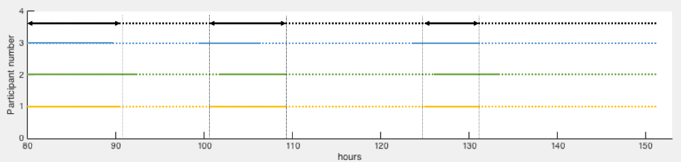
Algorithms to find appropriate location
3. Calculating the length of a meeting’s productive time
For participant 1,2,3…
Productive time vs Non-Productive time
For meeting
Productive time vs Non-Productive time

Slide 28
Algorithms to find an appropriate location
4. Searching for the appropriate meeting location
Method 1. Divide-and-Conquer method
Section1
Section2
Section3
Section4
Section5
Section6
Section7
Section8
Section9

Slide 29
Algorithms to find an appropriate location
4. Searching for the appropriate meeting location
Method 1. Divide-and-Conquer method
Section1
Section2
Section3
Section4
Section5
Section6
Section7
Section8
Section9

Slide 30
Algorithms to find an appropriate location
4. Searching for the appropriate meeting location
Method 1. Divide-and-Conquer method
Section1
Section2
Section3
Section4
Section5
Section6
Best place!!
Section7
Section8
Section9

Slide 31
Algorithms to find an appropriate location
4. Searching for the appropriate meeting location
Method 2. Greedy method
Total 6977 airports

Slide 32
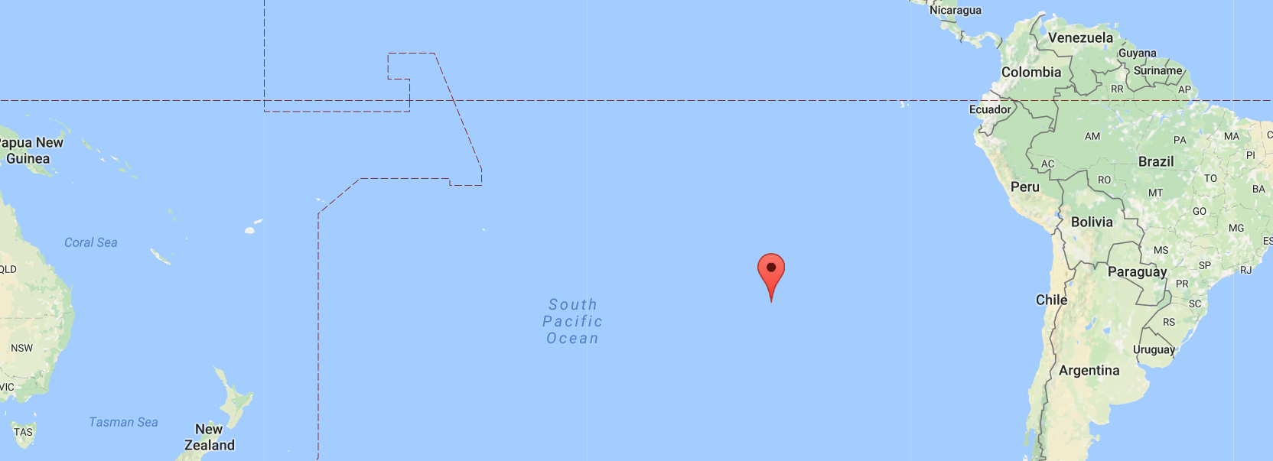
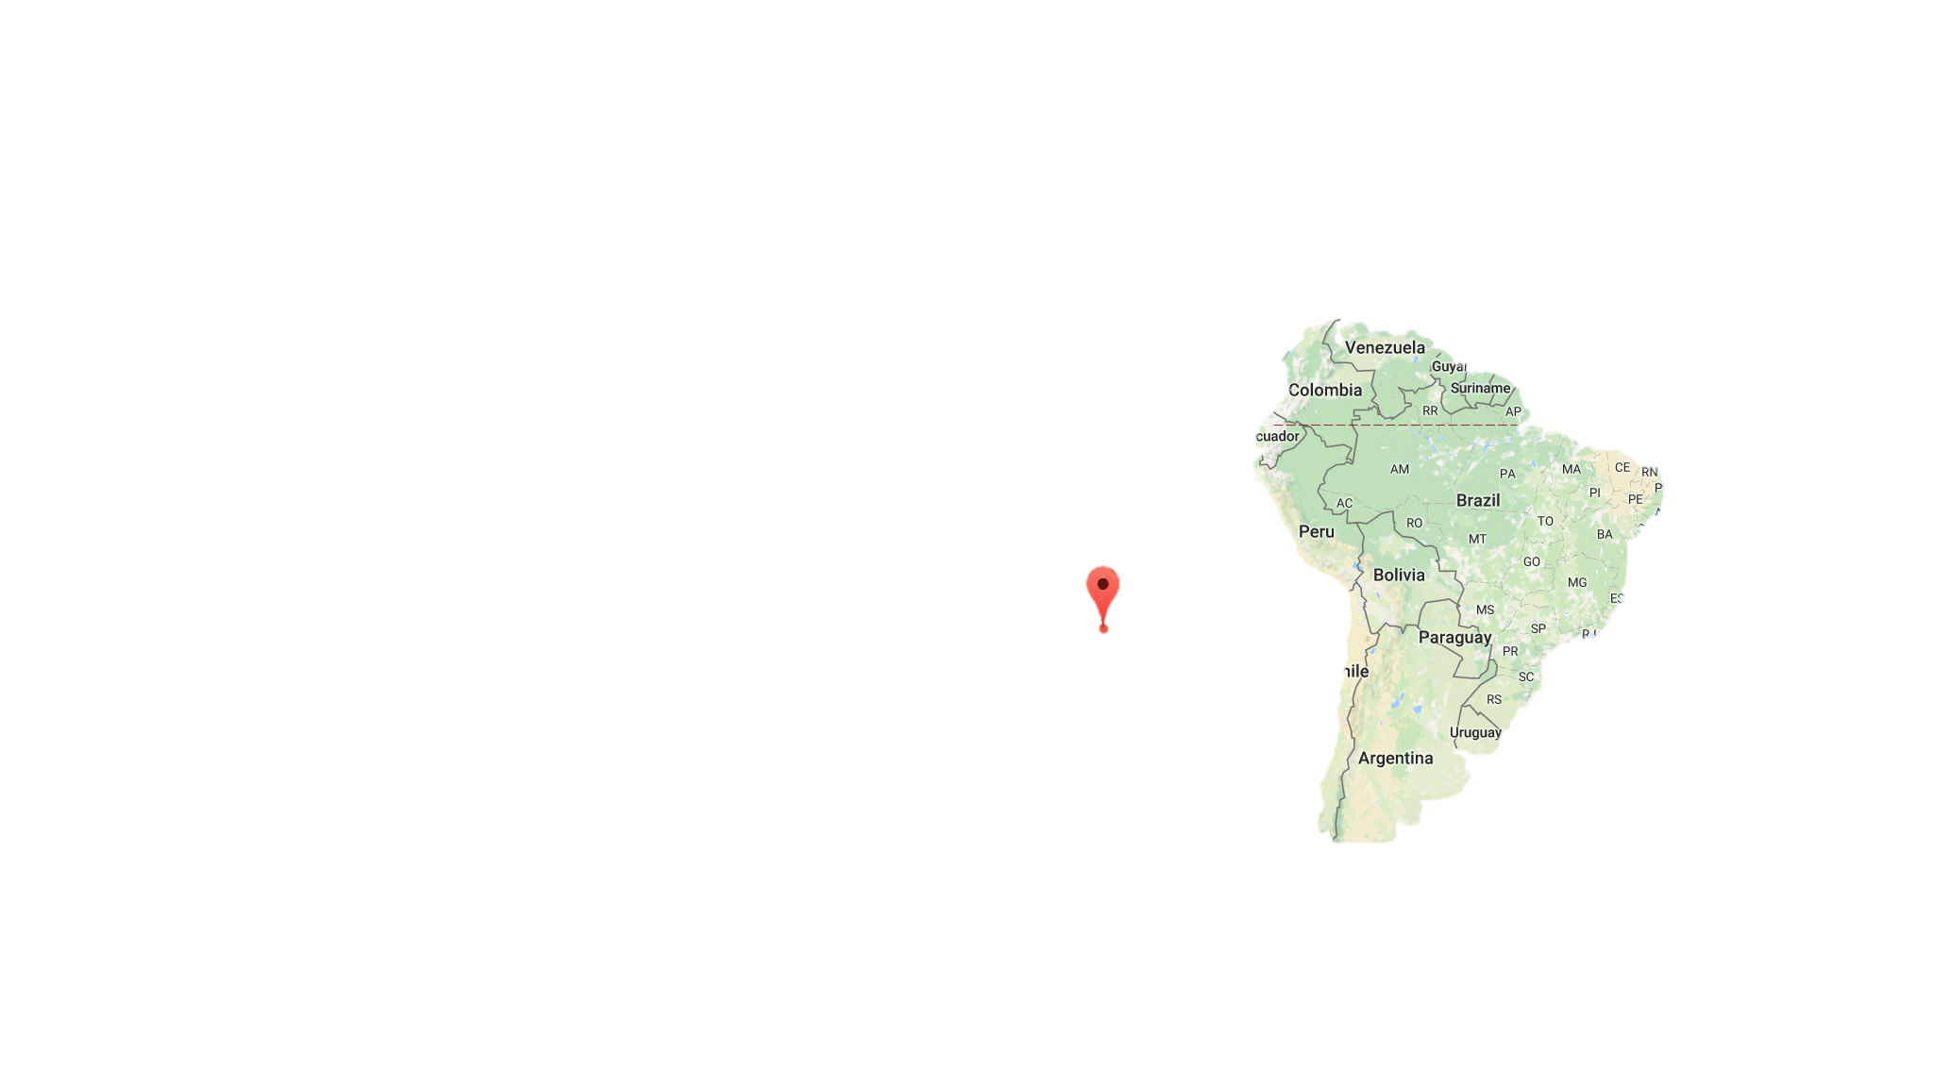
Scenario 1. Small meeting
Method 1. Divide-and-Conquer method | Method 2. method
22°21′54"S 98°10′33.6"W | Chile, Easter Island, Hanga Roa
Method 1
Method 2

Slide 33
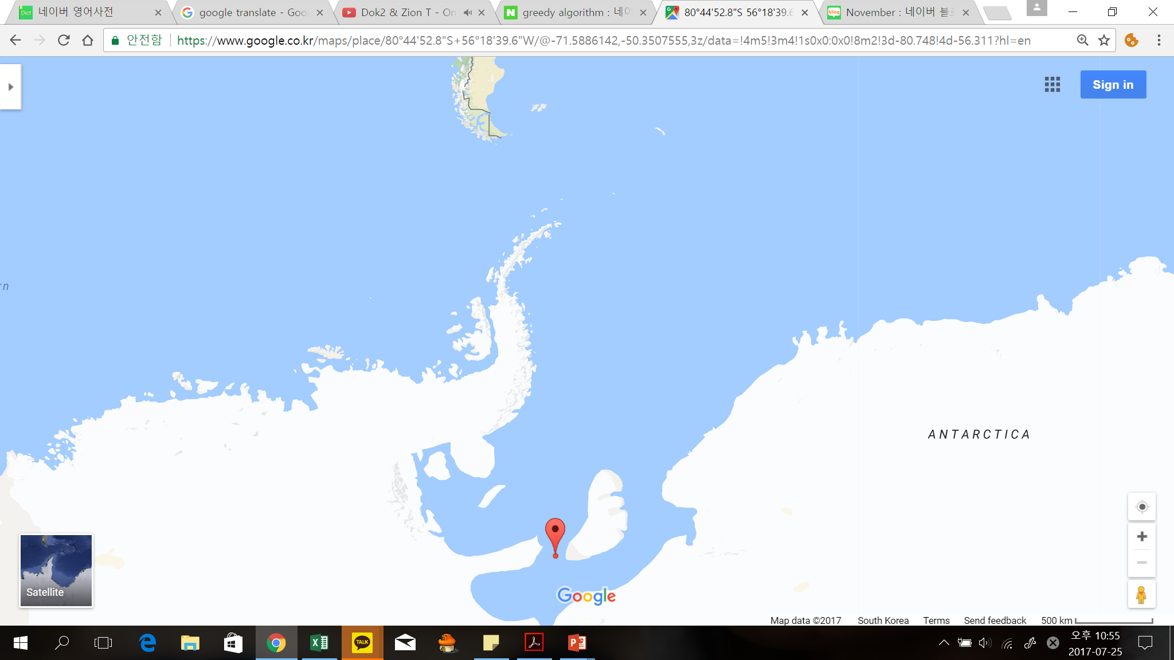
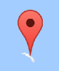
Scenario 2. Big meeting
Method 1. Divide-and-Conquer method | Method 2. method
80°44′52.8"S 56°18′39.6"W | Grytoiken, South Georgia islands’ airport
Method 2
Method 1

Slide 34


Conclusion
Goal
Find the Most Productive Location
Part. I : Define productive meeting
Part. II : Find best location
G
A
Productive
Productive
Section1
Section2
Section3
F
$$2/3$$
Non- Productive
Section4
Section5
Section6
B
Non- Productive
E
Section7
Section8
Section9
Home place
plane
Meeting place
C
Productive
Non- Productive
D
8:00
Productive
$$\frac{dF}{dt}= f_{1}E−f_{2}R$$
Modeling & Comparing

Slide 35

Thank you
20°46′50.6"S 138°34′01.5"W
Tureia, French Polynesia’s airport
for listening

